Slide 1

Analytic Computing
Fachpraktikum
Marine anomalies detection
08.02.2023
Qiuming Li
Zhenhao Xu

Slide 2
Contents
1. Motivation
2. Basic Information
3. Goal and Basic Ideas
4. Features Selection
5. Data Generation
6. Date Preprocessing
7. Model Selection
8. Train/Test Dataset
9. Evaluation
10. Results Analysis and Optimization of models and datasets
11. Real accident test
12. Ideas for improvement

Slide 3
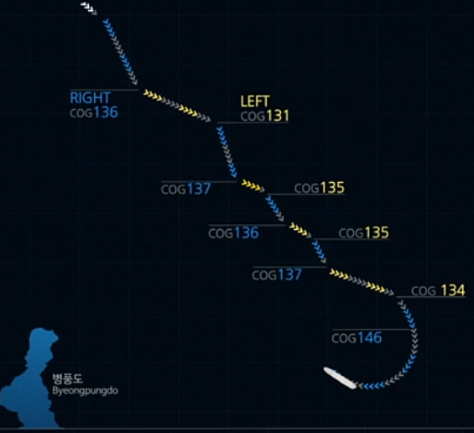
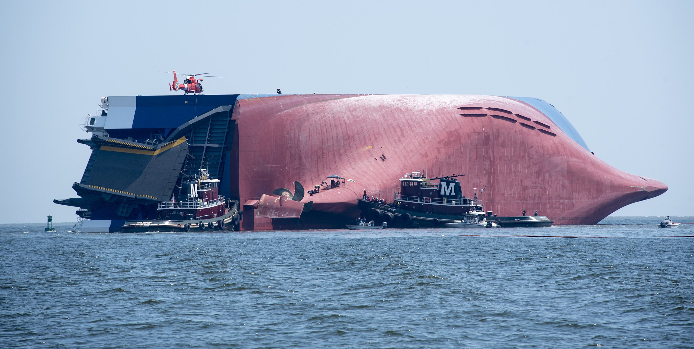
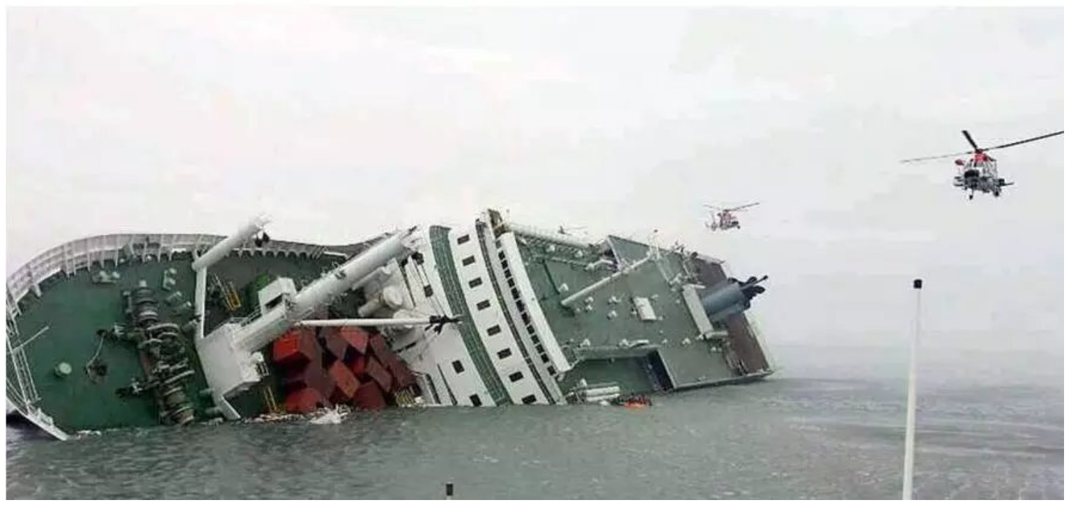
1. Motivation
MV Golden Ray capsized on 08.09.2019 within the Port of Brunswick's harbor
The ferry MV Sewol sank on the morning of April 16, 2014, an route from Incheon towards Jeju in South Korea, 306 died in the disaster, including around 250 students.
The automatic detection of abnormal behaviour of vessels in ports and sensitive waters and the implementation of early warnings are of great importance in ensuring water traffic safety.

Slide 4
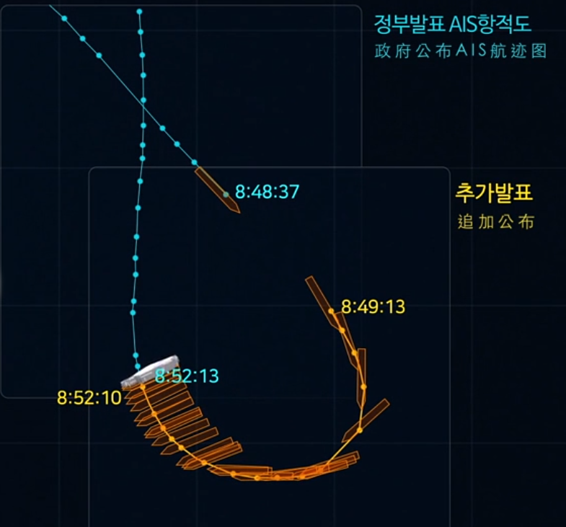

2. Basic information
AIS: Automatic Identification System
MMSI | BaseDateTime | LAT | LON | SOG | COG
367369550 | 2019-09-08T00:00:06 | 31.14314 | -81.49662 | 12.3 | 122.8
AIS is an automated, autonomous tracking system that tracks the location of vessels anywhere they are in the world.
MMSI: Maritime Mobile Service Identity, LAT/LON: latitude/longitude
SOG: Speed over Ground, COG: Course over Ground

Slide 5
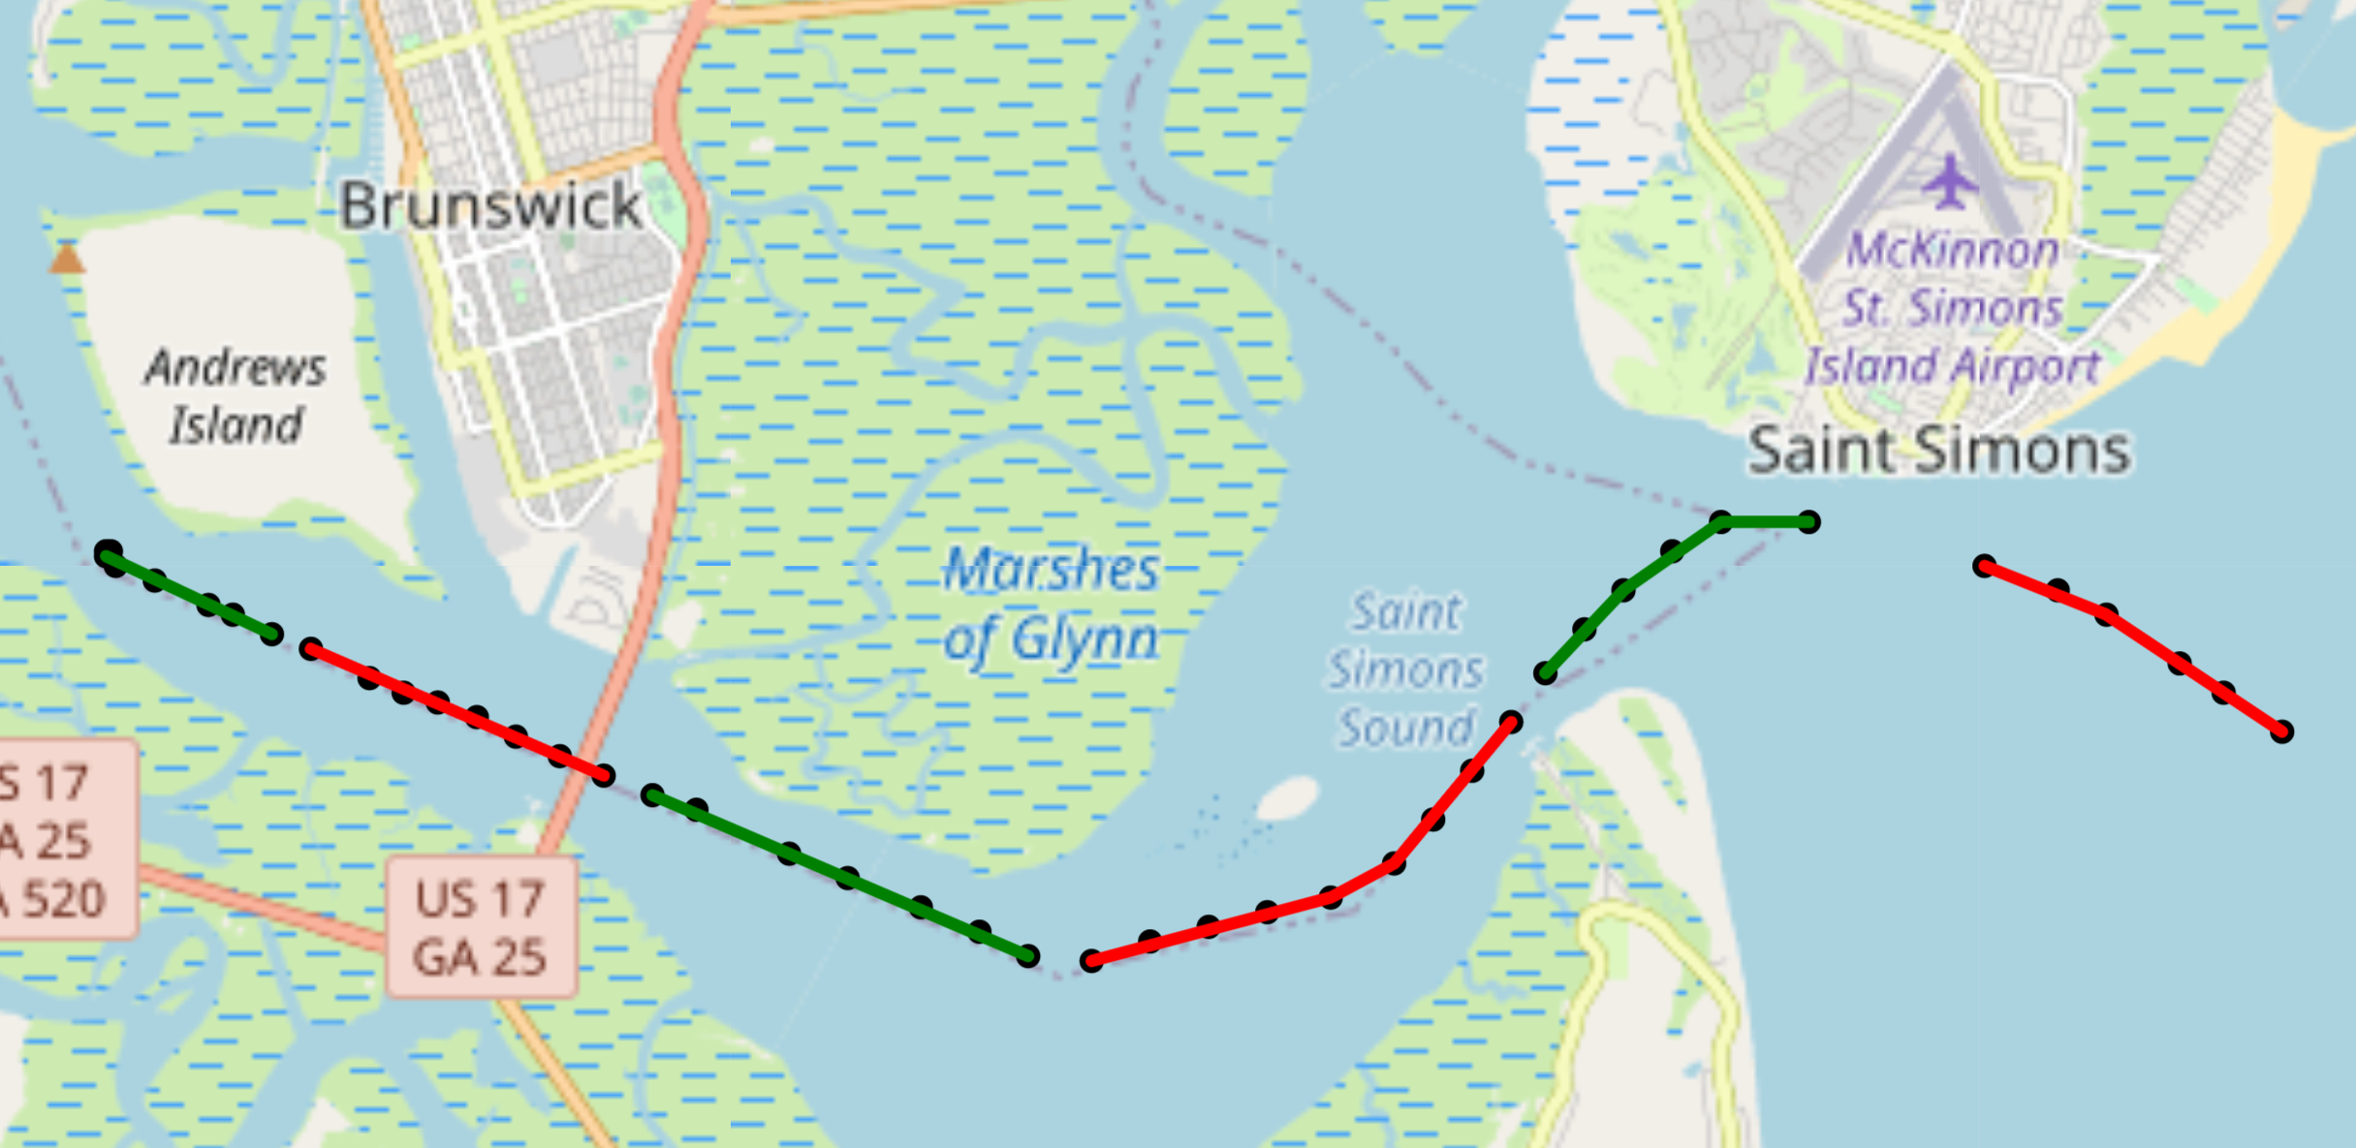
3. Goal and Basic Ideas
3.1 What is our goal？
Our goal is to detect if this segment is anomalous!!
The colour here is only to distinguish the segments
3.2 What is segment？
We pack all AIS signals (Each point on the map is a signal) of one ship in 10 min(max. 10 signals).
And we think of it as a segment of the ship‘s trajectory.

Slide 6
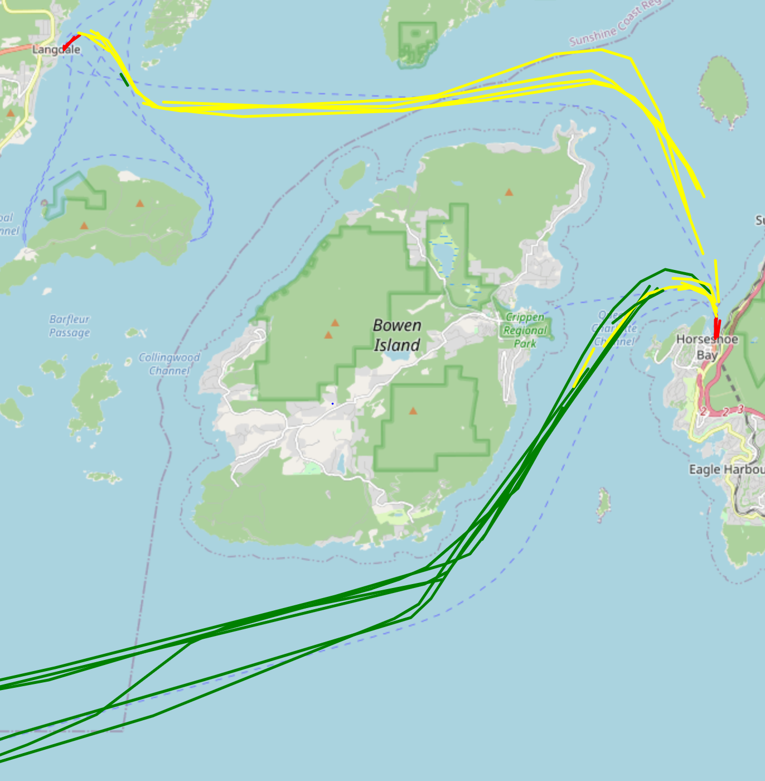
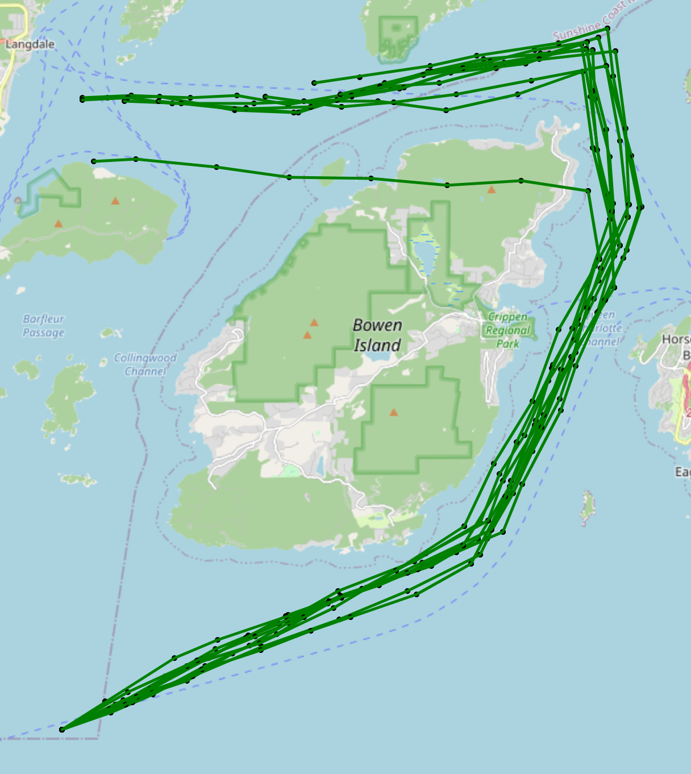
3. Goal and Basic Ideas
3.3 Method: Supervised learning
We use supervised learning to train the model, so we need to set labels for the dataset to distinguish between abnormal and normal data.
Set up abnormal scenarios and simulate abnormal data
Treat all simulated data as anomalous
Treat all real data as normal

Slide 7
4. Features Selection
SOG: Speed over Ground
COG: Course over Ground
Distance: Calculate the distance between two points by using the latitude and longitude of the two adjacent points
Data
point2
COG
SOG
Diff latitude
Data
point1
Distance
Diff longitude
So we select 3 Features for each time points, and each segment have max. 10 time points.
We can use a 10x3 array to describe the entire segment

Slide 8
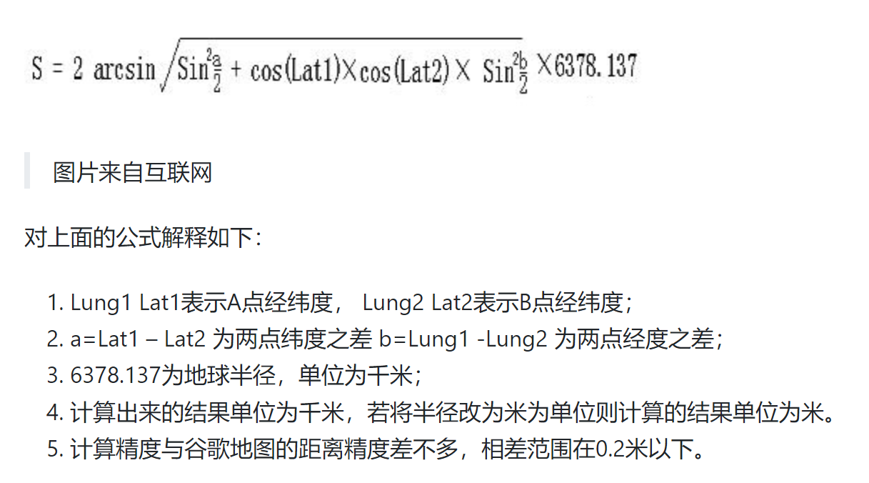

Slide 9
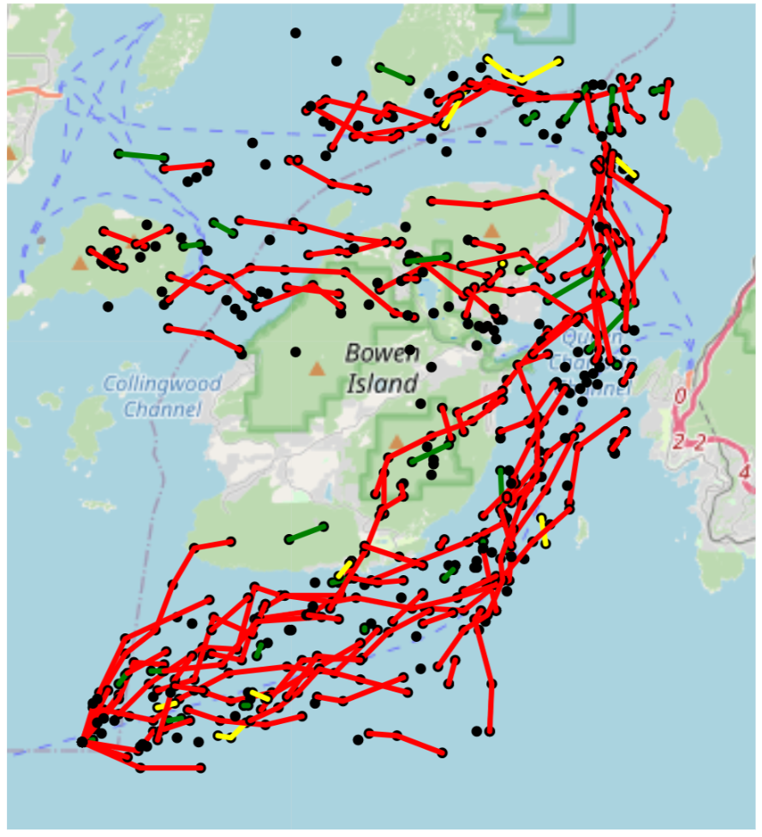
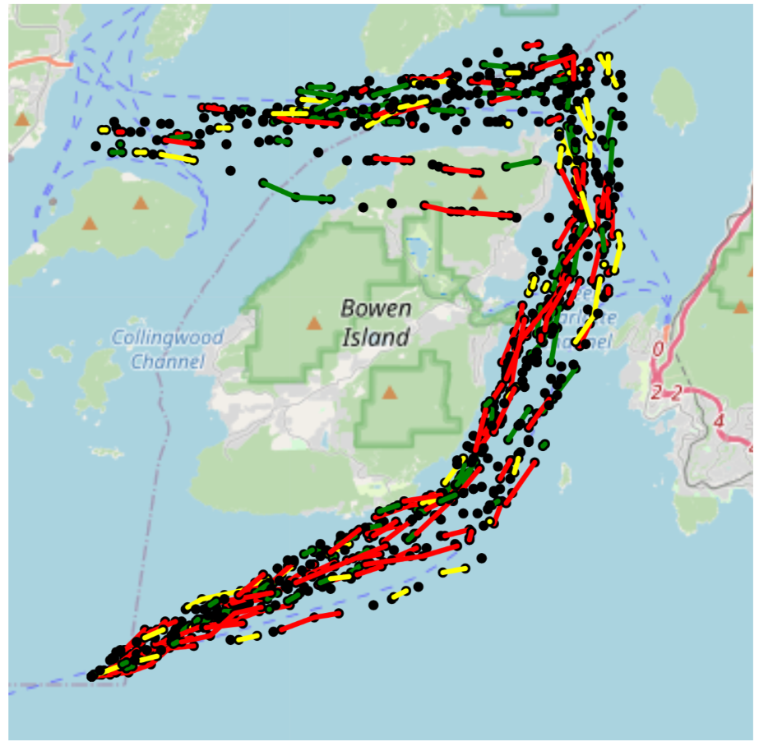
5. Data Generation
Firstly generate points and then make segments

Slide 10
6. Data preprocessing
N times real Data Segments of each Ship in each 10 min. so its 10x3 2DArray
combined and be saved in 3D Array (N+M)x10x3
Model
Origin_real_Data
Select Region
real_Data_region_1
Segmentation
generation
M times Segment (5 ships) generated Data of each Ship in each 10 min. so its 10x3 2DArray
label for each Segment be saved in 2D Array (N+M)x2
Shape of Input data
2D Array (10x3) for each Segment
3D Array(number of Segments x 10 x 3) for whole input dataset
Shape of Output data
1D Array (2) for each Segment, normal or abnormal
2D Array(number of Segments x 2) for whole input dataset

Slide 11
7. Model selection
7.1 Why CNN-Model?
1D-CNN model always be used in radio detection, to detect 1D Time Series Segments. Its similar to our project. …………………For example: ………….

Slide 12
7.2 CNN-Model structure
Input, shape: 10x3
convolution 1st layer
convolution 2nd layer
Maxpooling
convolution 3rd layer
Maxpooling
Flatten
Dense 1st layer
Dense 2nd layer
Dense 3rd layer
Dense final layer
Output, shape: 1x2

Slide 13
8. Train/Test Dataset
Train Dataset: 30 ships real normal data in 2019_01_01 in selected area
15 ships random generation abnormal data in selected area
Test Dataset: 30 ships real normal data in 2019_06_01 in selected area
15 ships random generation abnormal data in selected area
Dataset for real accident test:
1. 20 ships real normal and abnormal data in 2019_09_08 in the area the accident happens
2. 20 ships real normal and abnormal data in 2019_09_07 in the area the accident happens

Slide 14
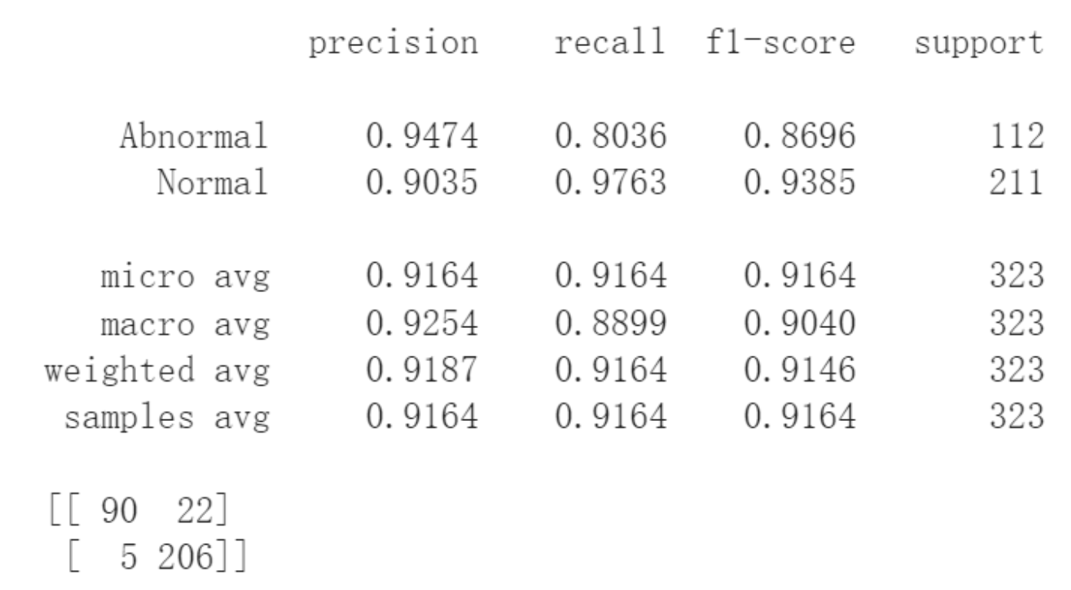
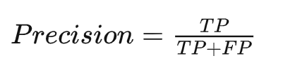
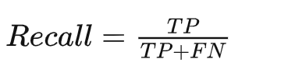
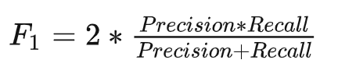
9. Evaluation
For example:
Confusion Matrix |  | Predicted results
 |  | Negative | Positive
Ground Truth | Negative | True Negative(TN) | False Positive(FP)
 | Positive | False Negative(FN) | True Positive(TP)
For example:
Precision reflects the ability of the model to discriminate between negative samples.
Recall reflects the ability of the model to discriminate between positive samples.
F1 score is a combination of both

Slide 15
CNN-Model1
10. Results Analysis and Optimization of models and datasets
We did 6 tests with different models and datasets pairings
10.1.1 Result_1 and Result_2
 | Dataset_1
CNN-Model_1 | Result_1
CNN-Model_2 | Result_2
CNN-Model2
1. use 2 features: SOG COG
1. use 3 features: Distance SOG COG
Dataset_1
1. if there are missing signals in each segment, supplement missing signals with 0.
2. but in generation data there is no missing signal

Slide 16
10.1.2 Statistics View of Result_1 and Result_2
The result was so good that we doubted it:
In real data there are not always 10 data points in each segment, Even in most cases there are only one or two data points per segment and the rest is zero.
But in generation data there are always 10 data points in each segment.
This is the differences we don‘t want the model to take into account. Its overfitting, so we try to change the data set to avoid overfitting.
See next slide
 | Dataset_1 | Dataset_2 | Dataset_3
CNN-Model_1 | Result_1 | Result_3 | Result_5
CNN-Model_2 | Result_2 | Result_4 | Result_6

Slide 17
CNN-Model1
10.2.1 Result_3 and Result_4
 | Dataset_1 | Dataset_2
CNN-Model_1 | Result_1 | Result_3
CNN-Model_2 | Result_2 | Result_4
NEW Results!
CNN-Model2
1. use 2 features: SOG COG
1. use 3 features: Distance SOG COG
Dataset_1
1. if there are missing signals in each segment, supplement missing signals with 0.
2. but in generation data there is no missing signals
NEW Dataset!
Dataset_2
1. if there are less than 3 signals in one segment, drop it. otherwise supplement missing signals with 0
2. and in generation dataset there is random missing signals and supplement with 0

Slide 18
10.2.2 Statistics View of Result_3 and Result_4
NEW Results!
In Dataset_2 the generated data is more similar to the real data.
The model cannot simply distinguish between real and generated data by the number of zeros in the segment
So this result is much worse than Result_1 and Result_2
Maybe also because there is too little Information in each segment. So we change the dataset again.
 | Dataset_1 | Dataset_2 | Dataset_3
Model_1 | Result_1 | Result_3 | Result_5
Model_2 | Result_2 | Result_4 | Result_6
See next slide

Slide 19
CNN-Model1
10.3.1 Result_5 and Result_6
 | Dataset_1 | Dataset_2 | Dataset_3
CNN-Model_1 | Result_1 | Result_3 | Result_5
CNN-Model_2 | Result_2 | Result_4 | Result_6
NEW Results!
CNN-Model2
1. use 2 features: SOG COG
1. use 3 features: Distance SOG COG
Dataset_1
1. if there are missing signals in each segment, supplement missing signals with 0.
2. but in generation data there is no missing signals
Dataset_2
1. if there are less than 3 signals in one segment, drop it. otherwise supplement missing signals with 0
2. and in generation dataset there is random missing signals and supplement with 0
NEW Dataset!
Dataset_3
1. if there are less than 5 signals in one segment, drop it. otherwise supplement missing signals with 0
2. and in generation dataset there is random missing signals and supplement with 0

Slide 20
10.3.2 Statistics View of Result_5 and Result_6
NEW Results!
Now, there is enough Information in each segment.
So the results are much improved from Result_3 and Results_4
The model can also focus on the behavior of the ship itself rather than the integrity of the data.
 | Dataset_1 | Dataset_2 | Dataset_3
Model_1 | Result_1 | Result_3 | Result_5
Model_2 | Result_2 | Result_4 | Result_6
Next slide: Show results on the map

Slide 21
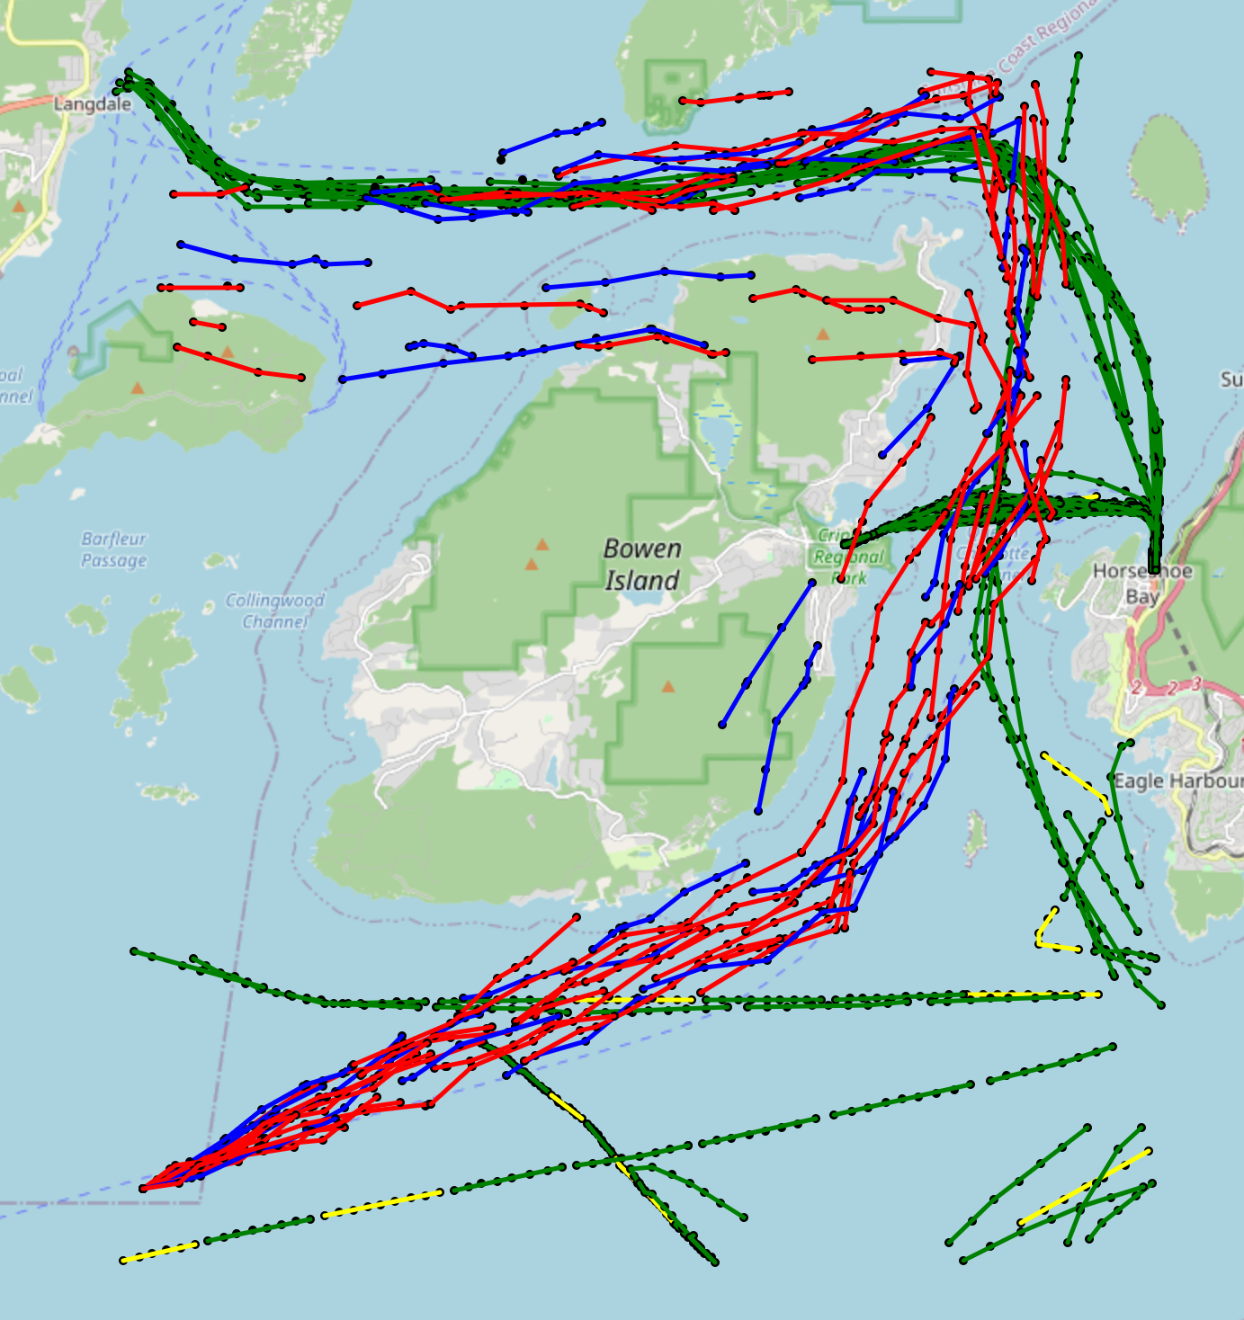
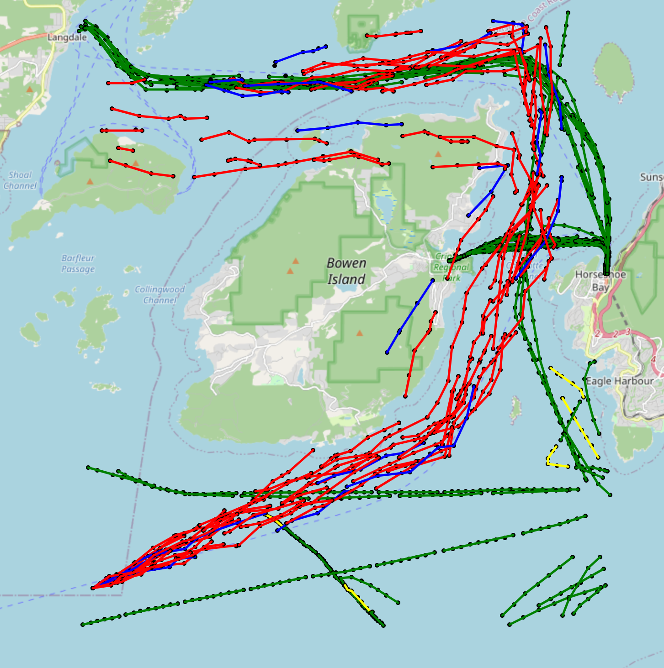
 | Predicted Negative | Predicted Positive
Actual Negative | Red (TN) | Blue (FP)
Actual Positive | Yellow (FN) | Green (TP)
10.3.3 Map View of Results
Result 5
Result 6

Slide 22
Model1
9. Optimization of models and datasets
1. use 2 features: SOG COG
Model2
1. use 3 features: Distance SOG COG
Dataset1 (Overfitting?)
1. if there are less than 10 time point in one segment, Supplement missing signals with 0
2. no missing data in generation dataset
Dataset2 (too little information?)
1. if there are less than 3 time point in one segment, drop it. otherwise supplement missing signals with 0
2. random missing data(at least 3 time point rest) in generation dataset, and supplement with 0
Dataset3 (the best)
1. if there are less than 5 time point in one segment, drop it. otherwise supplement missing signals with 0
2. random missing data(at least 5 time point rest) in generation dataset, and supplement with 0
Dataset4(just try)
1. All same as Dataset3 but the generation data seems like more unreal

Slide 23
10.1 Statistics View of results
 | Dataset_1 | Dataset_2 | Dataset_3
Model_1 | Result_1 | Result_3 | Result_5
Model_2 | Result_2 | Result_4 | Result_6

Slide 24
10. Comparing the performance of different models
10.1 Statistics View of results
 | Dataset_1 | Dataset_2 | Dataset_3 | Dataset_4
Model_1 | Result_1 | Result_3 | Result_5 | Result_7
Model_2 | Result_2 | Result_4 | Result_6 | Result_8

Slide 25
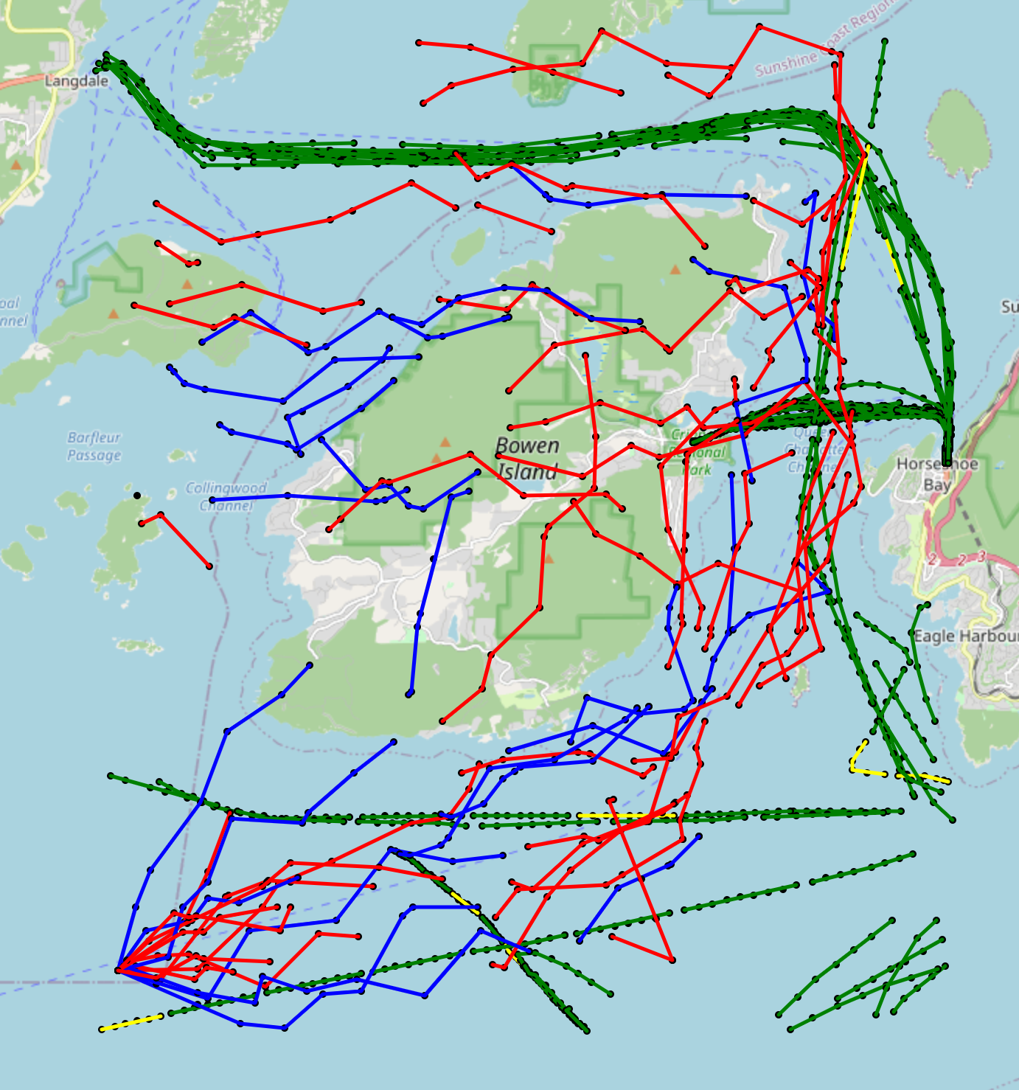
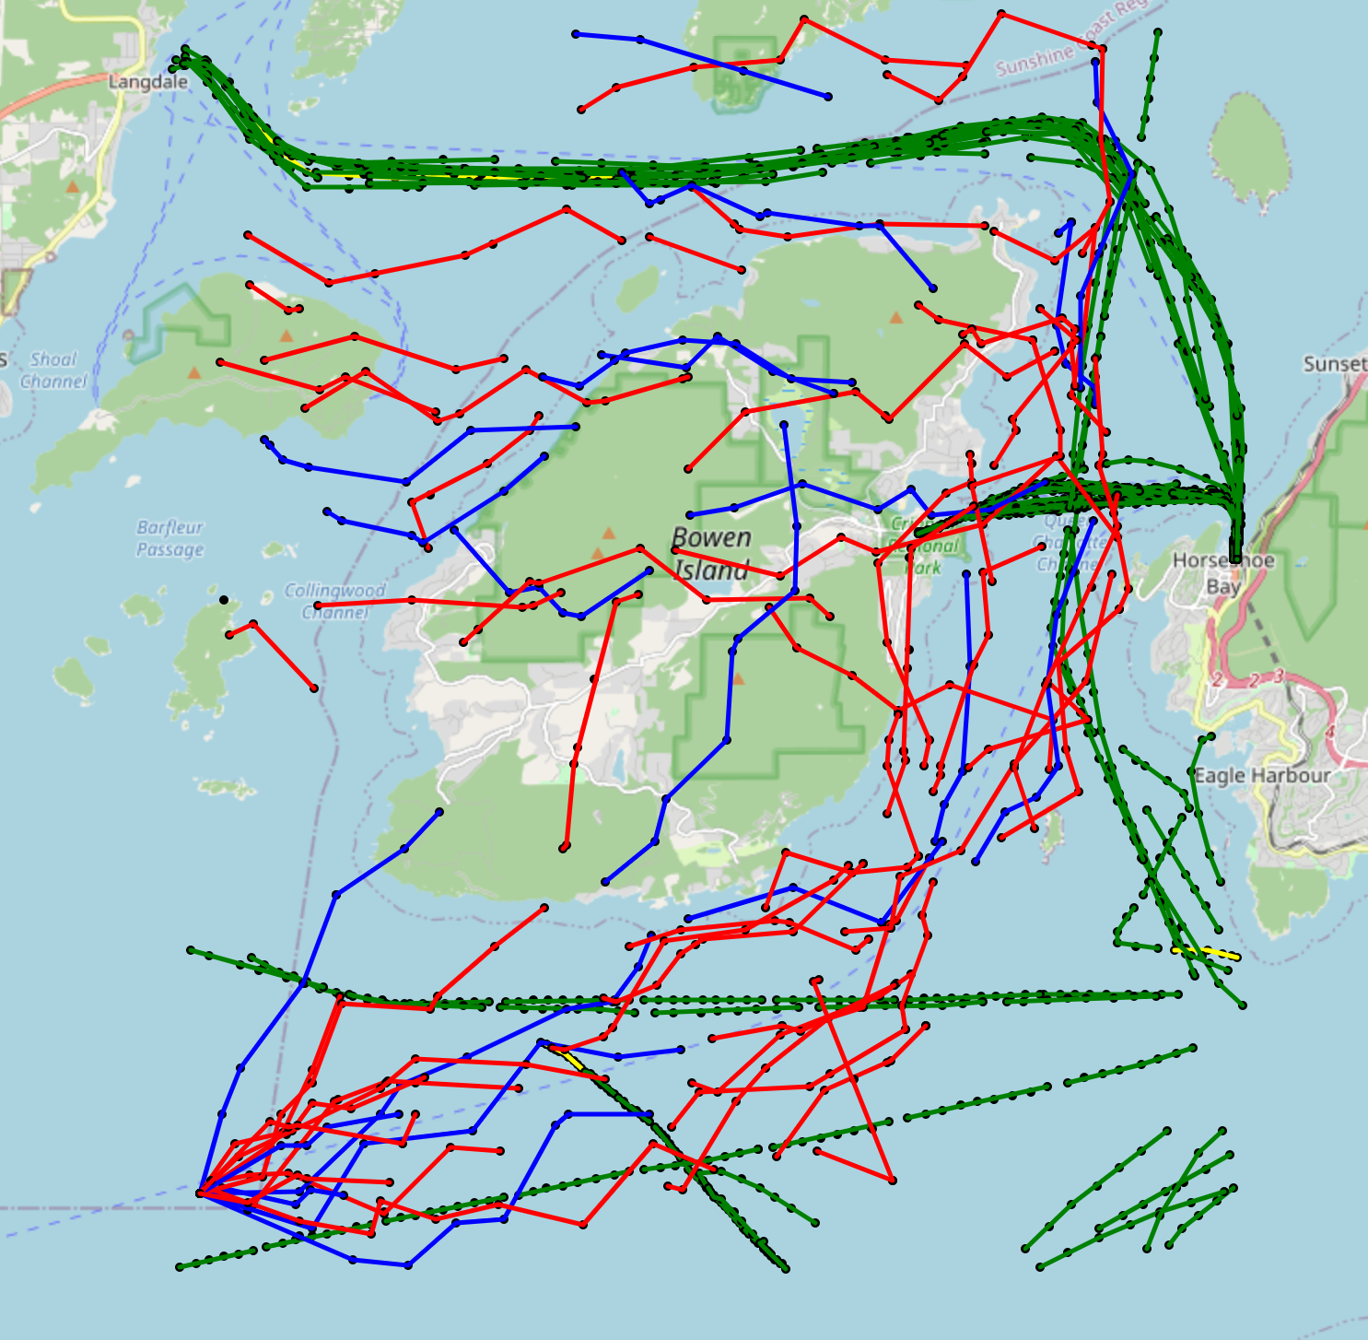
10.2 Map View of results
Result 7
Result 8

Slide 26
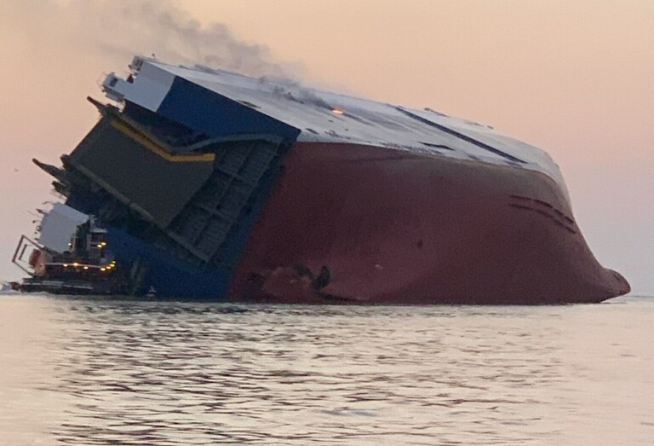
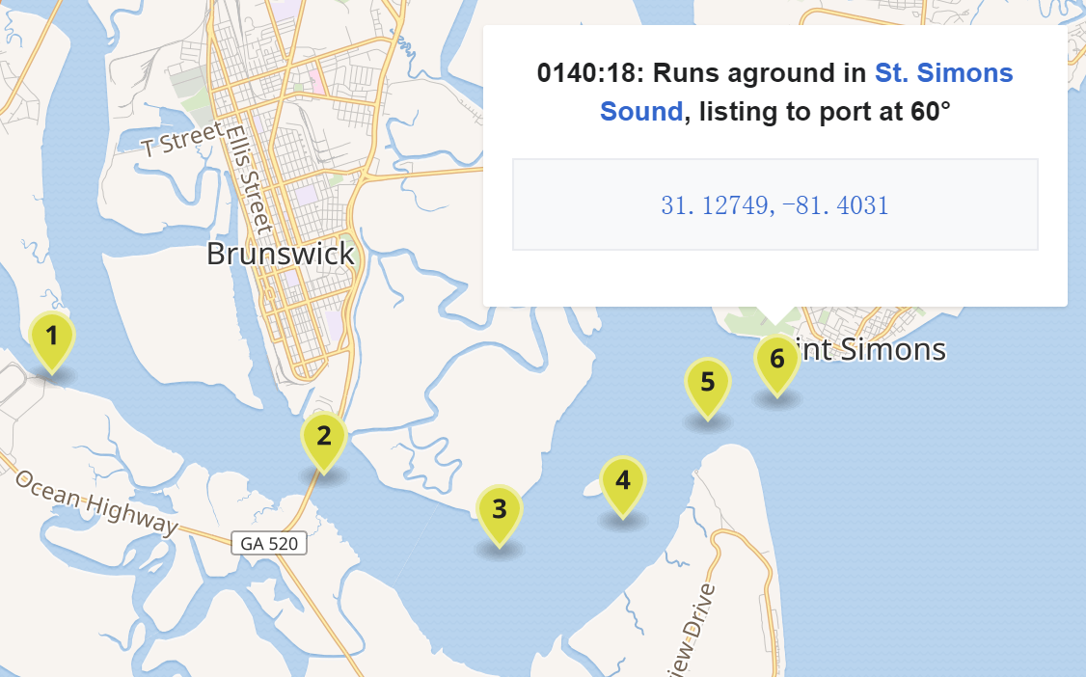
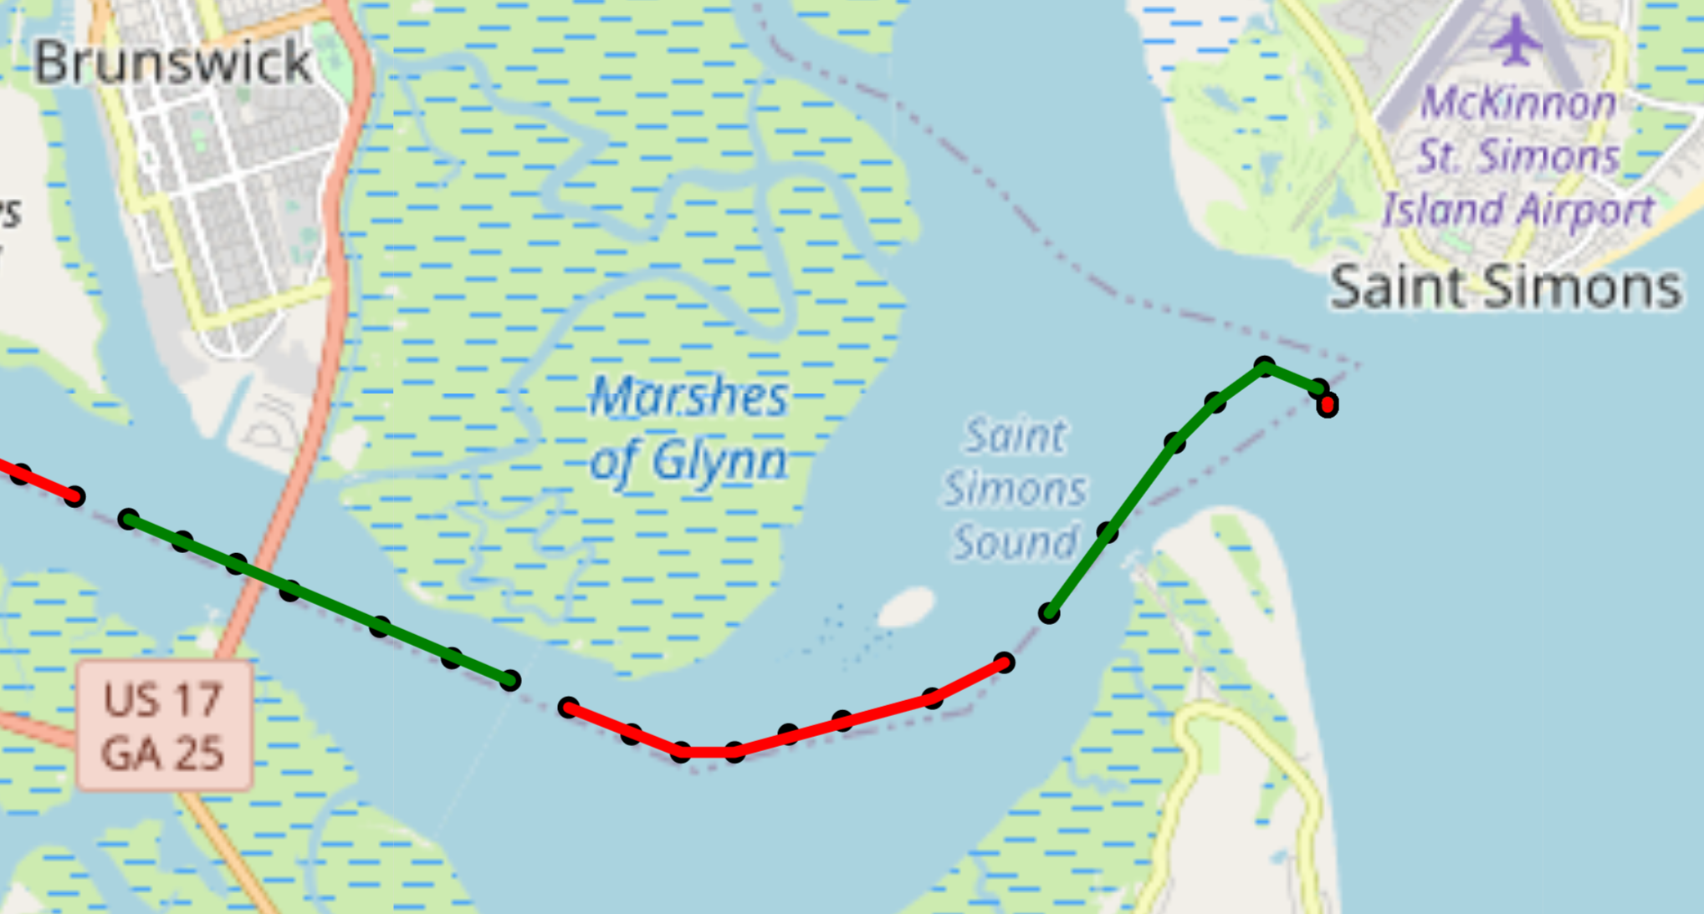
11. Real accident test
11.1 Real accident description：The MV Golden Ray was a 200-metre long (660 ft) roll-on/roll-off cargo ship，On 8 September 2019 at approximately 0137 EDT, the Golden Ray capsized within the Port of Brunswick's harbor, shortly after unberthing and proceeding towards the Port of Baltimore.
Wikipedia's reliable information on the location of the incident:
AIS data of the ship at the time of the incident that we found in the dataset:
The colour here is only to distinguish the segments

Slide 27
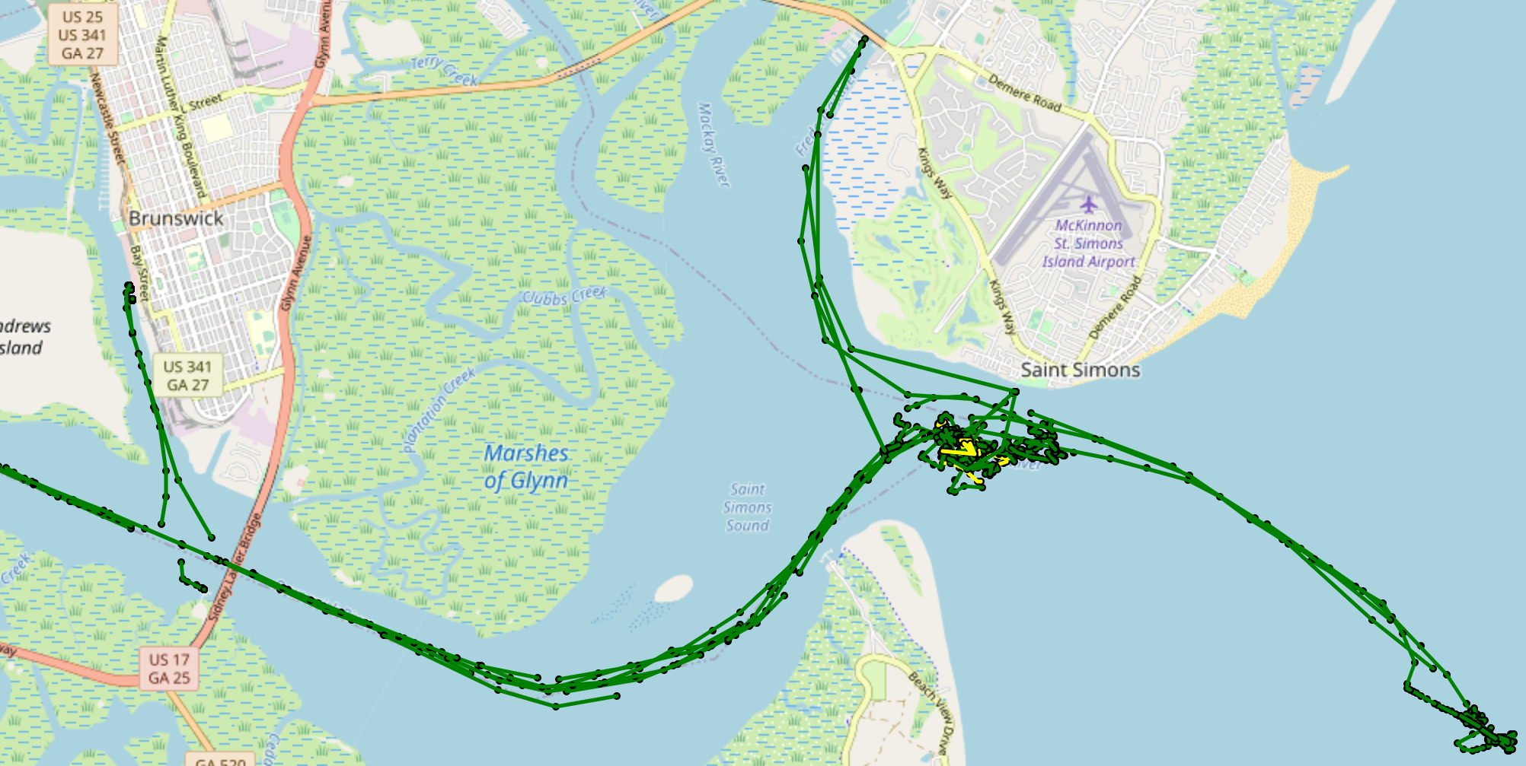
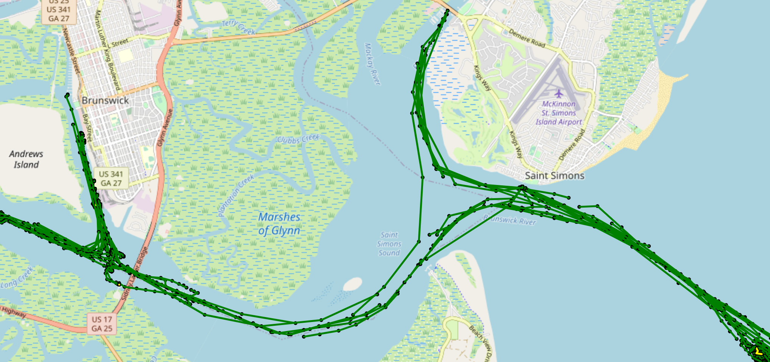
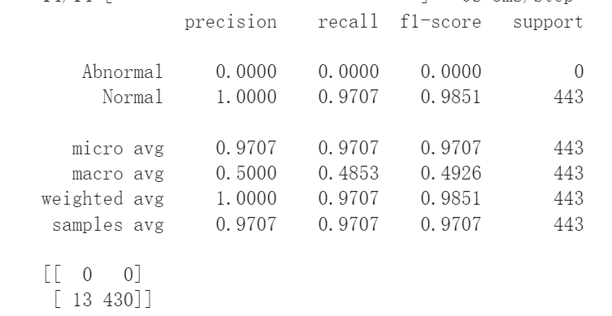
11.2. Performance of the Model Predict
 | Abnormal | Normal
Predict | Yellow | Green
Results from the Day of accident: 08.09.2019
Location of the incident!
Result from the Day before accident: 07.09.2019

Slide 28
12. Ideas for improvement
Find more realistic anomalous events or artificially set up more anomalous scenarios and simulate anomalous data based on them.
Cut segments in different ways for the same trajectory so that different segment data can be generated for data enhancement.

Slide 29

Q&A

